Slide 1
Gen PLC Application
Standard Control Software.

Slide 2
Sr No. | INDEX
1 | Introduction
2 | Submenus
3 | License Form
4 | Prefix Selection
5 | Excel Sheet Format
6 | File Selection Popup for Generation as per Selection
7 | “XML WITH TEST” and “AWL WITH TEST” Functionality
8 | Block Generation Cost Alert
9 | Login for Block Generation
10 | Project Selection for Block Generation
11 | Block Exists Handling
12 | Validation Report after AWL Files Downloaded
13 | Copy Project in V20 Folder for Further testing in TIA V20
14 | Select Blocks and TTST Files For Further Testing
15 | Detects Available Devices for Testing
16 | Final Output in CSV
17 | Popup for Select Blocks for Further Testing
18 | Generated Block Testing UI using TestSuite

Slide 3
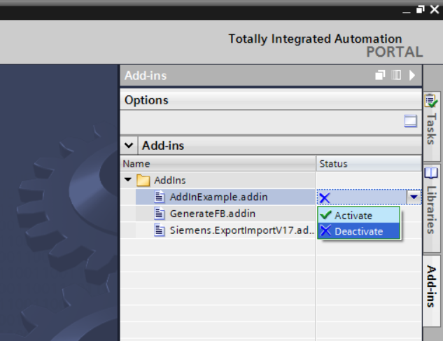
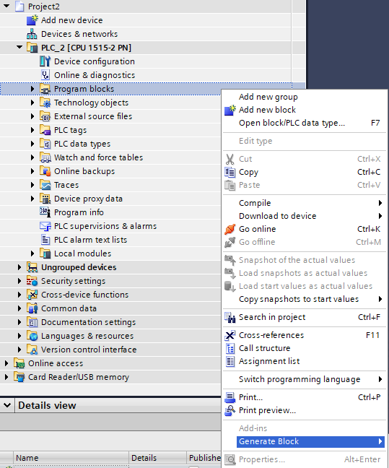
Gen PLC Add-in – Seamless Integration with TIA Portal
This document specifies the design of the Gen PLC Add‑in and companion console utilities. It covers the intended use cases, high‑level and detailed architecture, control flows for each menu, and a functionality walk‑through augmented with code screenshots.
Introduction
Content (bullet points):
Easily activate/deactivate from TIA Portal Add-ins menu
Adds Generate Block option in Program Blocks context menu
Simplifies AWL/XML import and block creation
Streamlines workflow for Excel validation and testing
Scope:
Orchestrates Excel → AWL generation
Handles AWL/XML import into Siemens TIA Portal projects
Provides optional Excel validation and pairing
Supports downstream testing via Test Suite
Visuals:
Left side: Screenshot of Add-in Activation (Add-ins menu)
Right side: Screenshot of Generate Block (context menu)

Slide 4
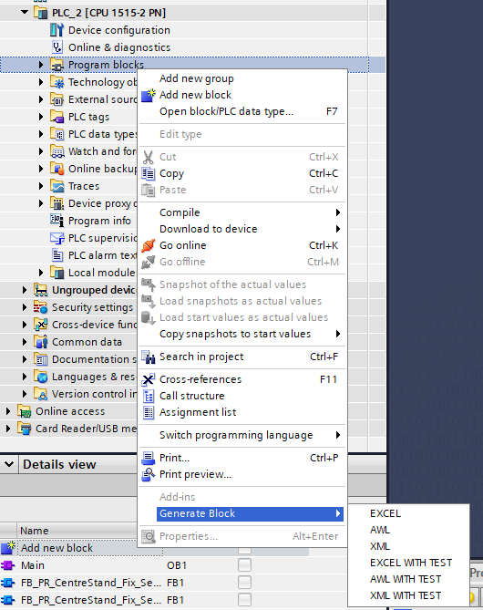
Submenus
Each submenu follows a consistent pattern of input selection, validation, backup/copy, import into TIA, and optional test hand‑off. The following flowcharts summarize the control paths.

Slide 5
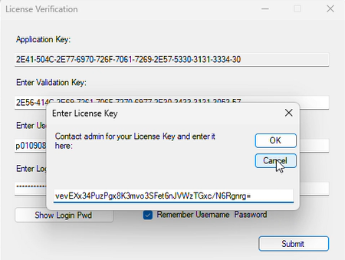
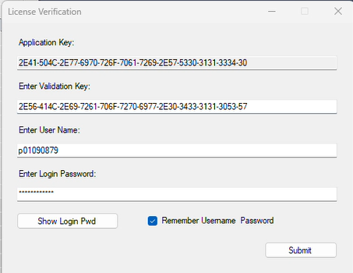
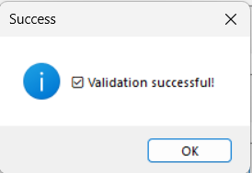
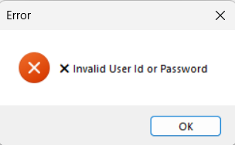
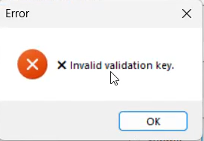
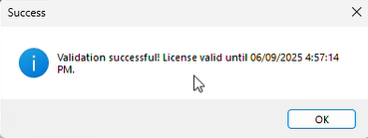
License Form
This module manages license validation and activation. It securely captures user credentials, validates keys, and automates the license request/renewal process through Outlook. It ensures local license storage with encryption, verifies expiry dates, and prompts renewal when necessary.
Login Process
STEP - I
User logs in using Application Key, User ID, and Password.
The Application Key is sent to the admin.
Admin provides a Validation Key to complete authentication.
STEP - II
On Submit, License key is sent to admin
Admin returns a License Key for verification
Validation Success Pop Up
Error Pop up for Invalid User ID,
Password
Error Pop up for Invalid Validation
Key
License validation successful with expiry date confirmation.

Slide 6
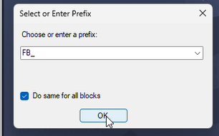
Prefix Selection
Loads previously saved prefix settings from a file (if available).
If not found, opens PrefixSelectionForm for user input.
Saves chosen prefix and “apply to all” option for future runs.

Slide 7
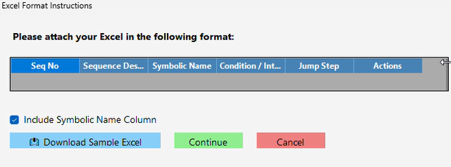
Excel Sheet Format
Validates the structure and content of an Excel sheet used for sequence data.
Checks Performed:
Ensures the sheet is not empty.
Verifies header names (with or without Symbolic Name column).
Confirms Seq No. is numeric and not empty.
Ensures Sequence Description is filled.
If present, validates Symbolic Name is not empty.
Reads supporting columns (Condition/Signal, Jump Step, Actions).
Purpose:
Guarantees the Excel file follows the expected format and data rules before processing, preventing invalid or incomplete input.

Slide 8
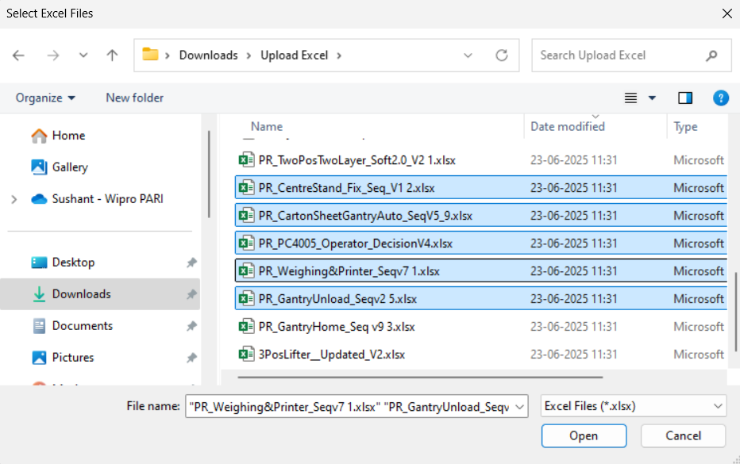
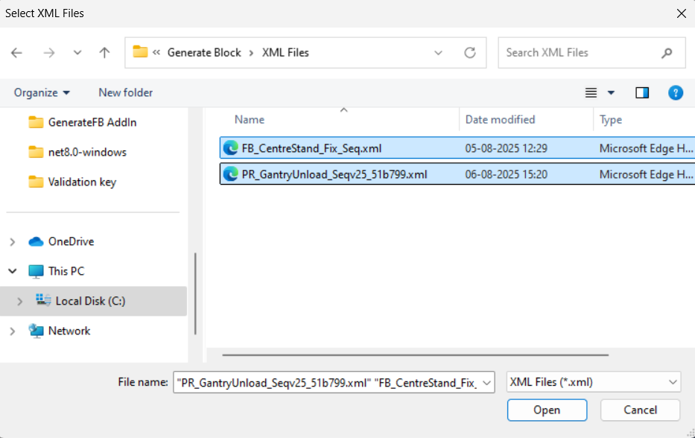
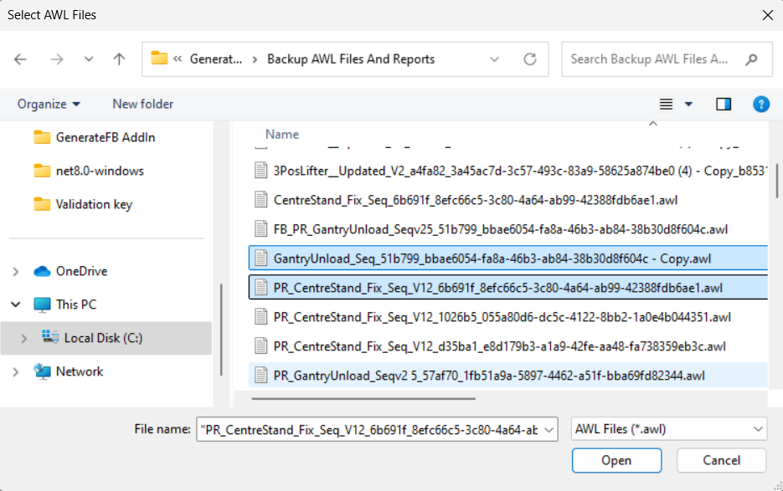
File Selection Popup for Generation as per Selection
EXCEL File Selection
XML File Selection
AWL File Selection

Slide 9
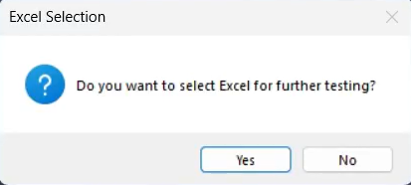
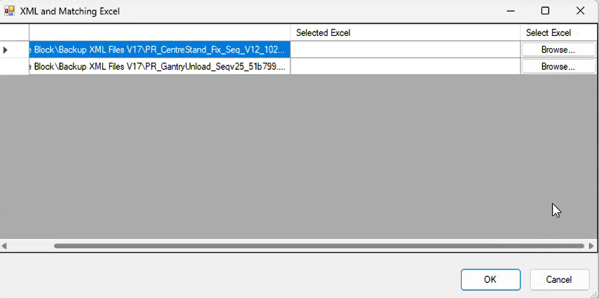
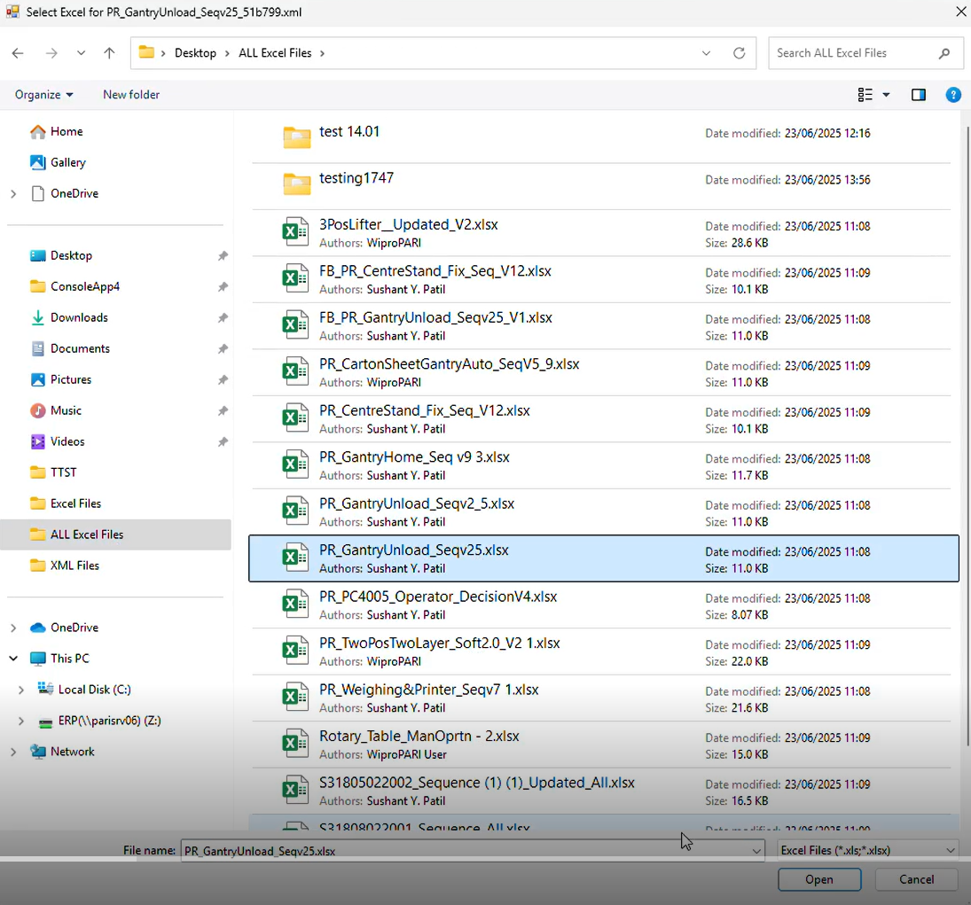
“XML WITH TEST” and “AWL WITH TEST” Functionality
- If Select “Yes” then below Excel selection window is open.

Slide 10
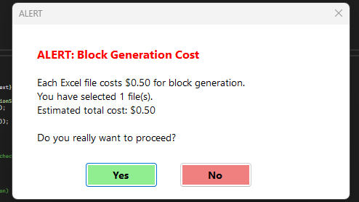
Block Generation Cost Alert
(Only For “EXCEL” & “EXCEL WITH TEST” Functionality)
Handles file selection and cost confirmation before processing. It shows an alert with cost details, lets the user confirm, copies selected files into a working folder, ensures required directories exist, and prepares variables for further processing with retry/error handling.

Slide 11
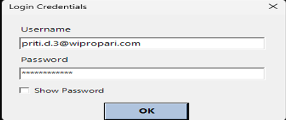
Login for Block Generation
Automates the AWL block generation process by:
Prompting user login through a custom form.
Configuring a headless Edge browser with secure download settings.
Checking and preparing input/output folders.
Logging into the web application and handling project selection.
Uploading Excel files and triggering block generation.
Monitoring upload status and saving results to the designated folder.
Purpose: Provides an end-to-end automated workflow for generating AWL files with minimal user effort.

Slide 12
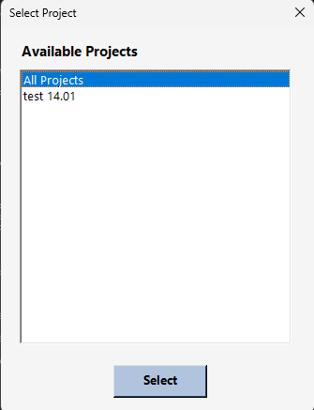
Project Selection for Block Generation
The user selects a project from the dropdown menu displayed within a popup window for block generation.

Slide 13
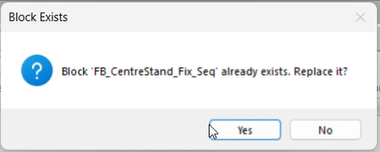
Block Exists Handling
If the same block already exists in the project, a popup is displayed.
Selecting Yes → overrides the existing block.
Selecting No → creates a new version (e.g., _1, _2, _3 …).

Slide 14
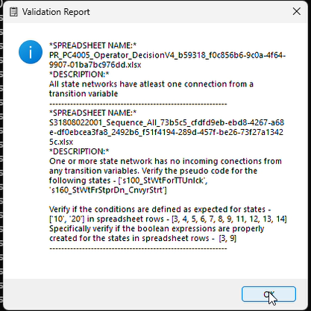
Validation Report after AWL Files Downloaded
The validation report provides a summary of results after AWL files are downloaded and processed. It highlights successful imports, detects errors or mismatches, and ensures that all required blocks are validated before further integration or testing.

Slide 15
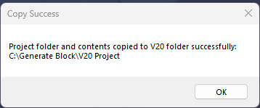
Copy Project in V20 Folder for Further testing in TIA V20
CopyProjectToV20Folder → Copies the entire project (files + subfolders) from its original location into C:\Generate Block\V20 Project. It first clears any existing contents in the destination folder, then performs a full copy.
In short → It creates a fresh copy of the project in a V20 backup folder for reuse.

Slide 16
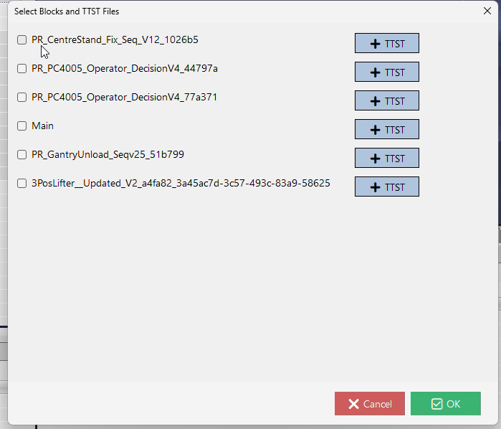
Select Blocks and TTST Files For Further Testing
Automates creating and preparing a TIA Portal project for testing:
Opens the latest .ap17 project file from the V20 Project folder.
Detects the PLC device and PLC software inside the project.
Displays a Block Selection Form so the user can choose which blocks to work with.
Ensures simulation mode is enabled, then saves the project.
Clears old export files and exports the selected blocks.
Prepares TTST test folders and updates .ttst files so each test set matches the selected block names.
In short: It opens a TIA project, lets the user pick blocks, exports them, and select matching TTST and update test files.

Slide 17
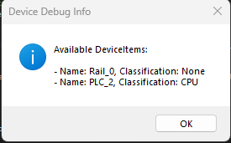
Detects Available Devices for Testing
Imports and runs TTST files in TIA Portal, configures PLCSIM for execution, downloads project to virtual PLC, collects test results, and exports consolidated logs and XML reports.

Slide 18
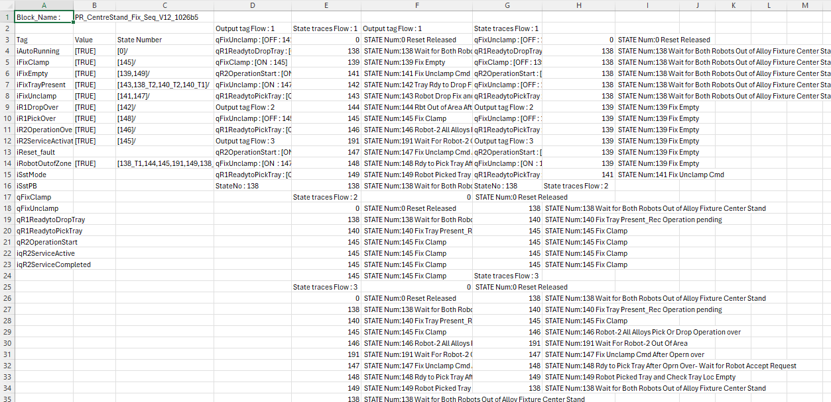
Final Output in CSV
This is the final output in CSV format after all processing is completed.
“The CSV output contains block names, tag values, state numbers, output tags, and state traces across multiple flows, providing a complete log of test execution results.

Slide 19
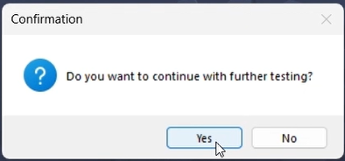
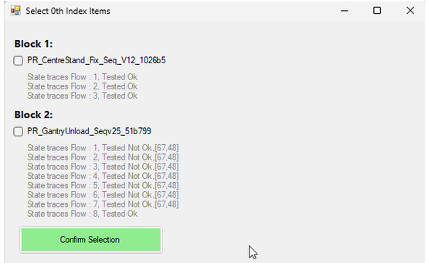
Popup for Select Blocks for Further Testing
This popup allows users to select specific program blocks for further testing. It displays the state trace results (Passed/Failed) for each block and provides a confirmation option to proceed with the chosen items, ensuring only relevant or critical blocks are validated in the next stage.

Slide 20
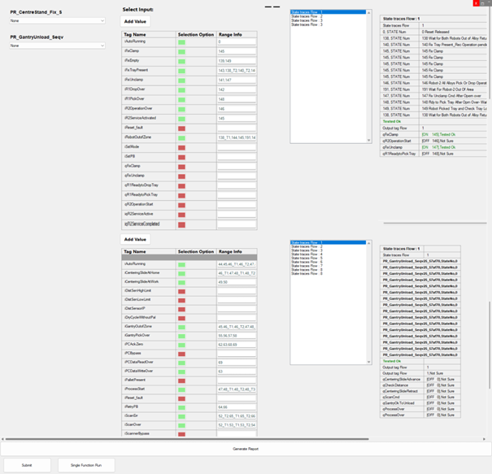
Generated Block Testing UI using TestSuite
The Generated Block Testing UI provides an interactive interface for verifying block functionality using TestSuite. It allows engineers to select input tags, define test ranges, and observe state trace flows. The tool automates validation, highlights test results, and generates structured reports to ensure block correctness and reliability.

